Slide 1
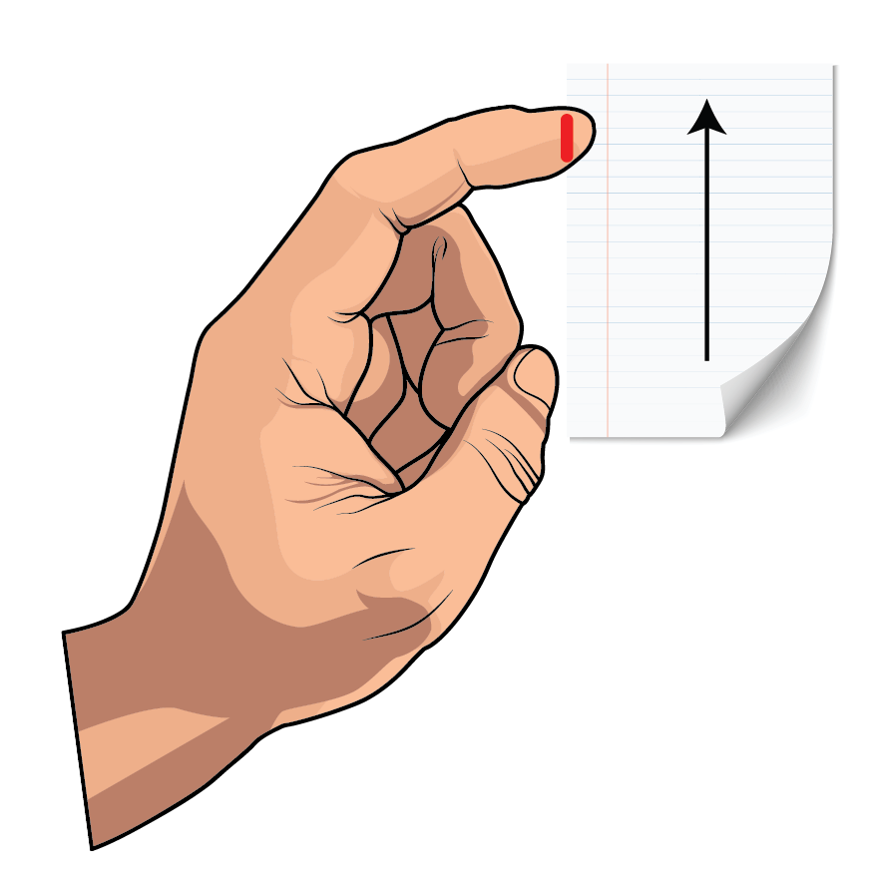



A competition between slicing and buckling underlies the erratic nature of paper cuts
Sif Fink Arnbjerg-Nielsen, Matthew D. Biviano, and Kaare H. Jensen khjensen@fysik.dtu.dk
Department of Physics, Technical University of Denmark www.papermachete.org
www.jensen-research.com

Slide 2
THE PAPER CUT PARADOX: Explaining why thin paper does not cut
Paper cuts are a common injury that can cause significant pain and discomfort [1]. Surprisingly, the physics underpinning a thin flexible sheet of paper slicing into soft tissues remains unresolved. (Other cases, such as chess-wire cutters, have been described; e.g., [2].) In particular, the unpredictable occurrence of paper cuts, often restricted to a limited thickness range, has not been explained.
Here, we visualized and quantified the motion, deformation, and stresses during paper cuts, uncovering a remarkably complex relationship between cutting, geometry, and material properties [3]. A model based on the hypothesis that competition between slicing and buckling controls the probability of initiating a paper cut was developed and successfully validated.
Our study reveals why paper with a specific thickness is most hazardous (≈65 μm, corresponding, e.g., to dot matrix paper or printed scientific journals). Based on our results, we developed the Papermachete, a cost-effective paper-based scalpel. It uses scrap paper blades and can easily cut vegetables and meat. To 3D print your own, use the files accessible here.
Website: www.papermachete.org
Email for correspondence: khjensen@fysik.dtu.dk
References
[1] Mirsky, S., The unkindest cut, Scientific American 306, 80, 2012
[2] Reyssat, E., Tallinen, T., Le Merrer, M., & Mahadevan, L. Slicing softly with shear. Physical review letters, 109(24), 244301, 2012
[3] Arnbjerg-Nielsen S. F., Biviano M. D., & Jensen, K. H., Competition between slicing and buckling underlies the erratic nature of paper cuts, Physical Review E (2024) www

Slide 3
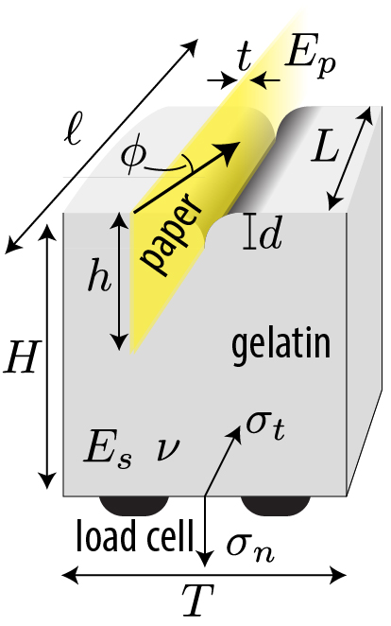
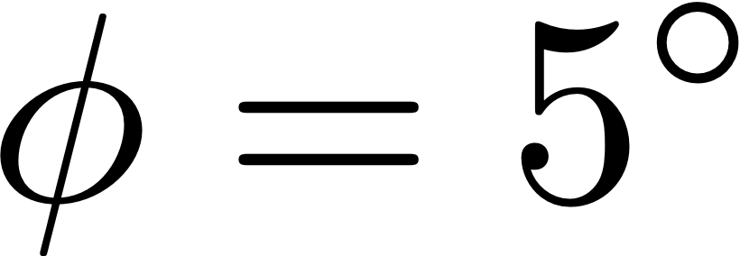
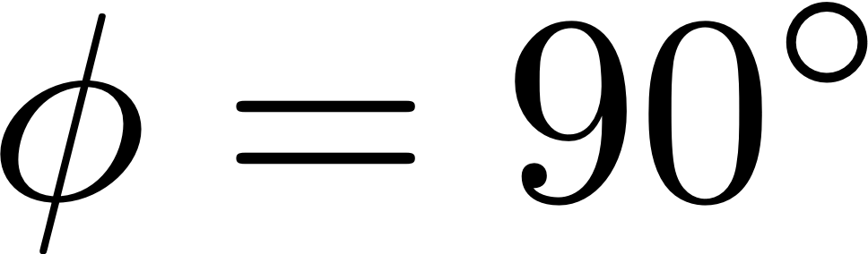
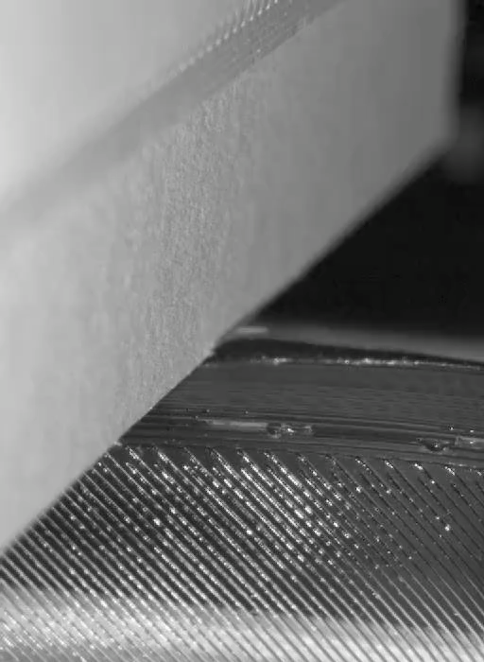
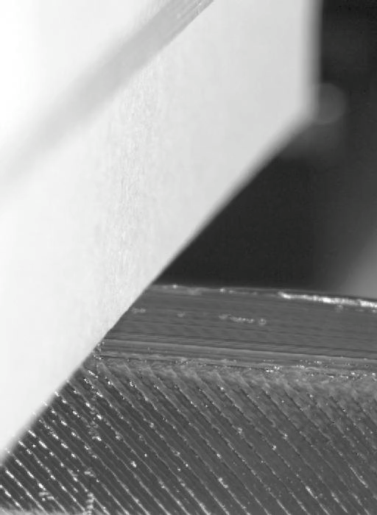
We built a paper cutting machine
Notes:
Illustration
Fotografi
Måske en kraftmåling?
Video
Clear experimental presentation - maybe show a high and a low angle motion
Experimental setup - we can vary these things (angle, thickness, position)
Segue: "In order to investigate this question, we ..."
interaction behavior = regime
Write angle on the videos

Slide 4
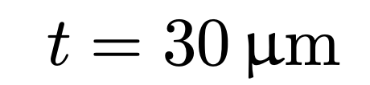
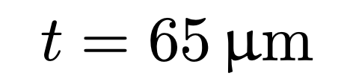
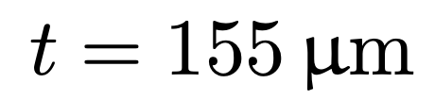
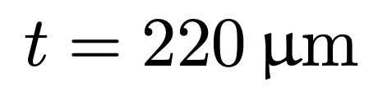
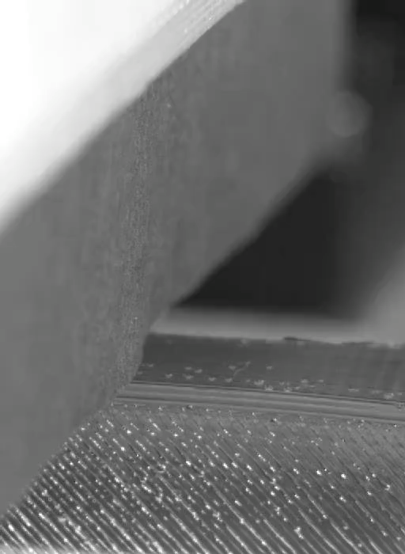
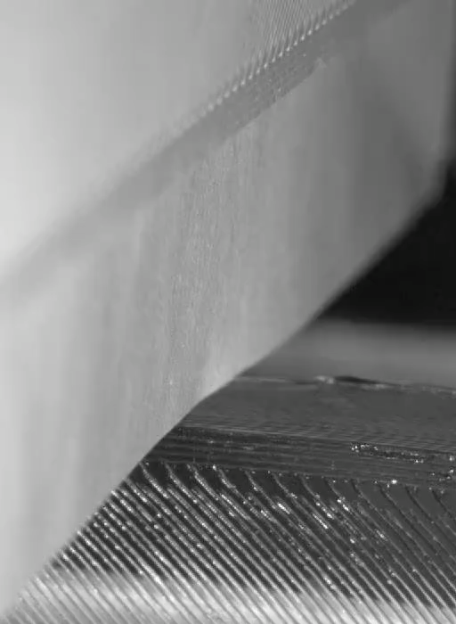
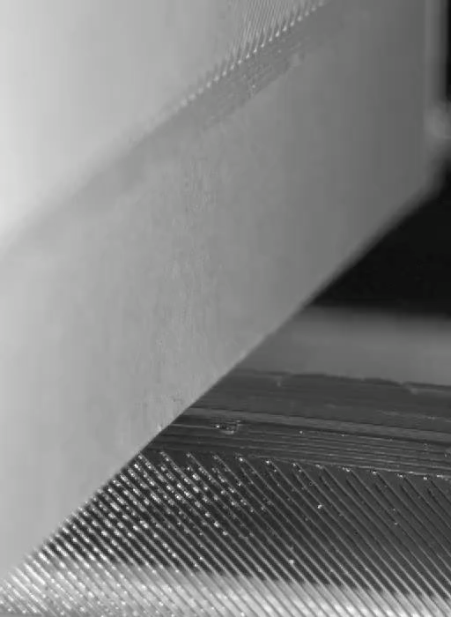
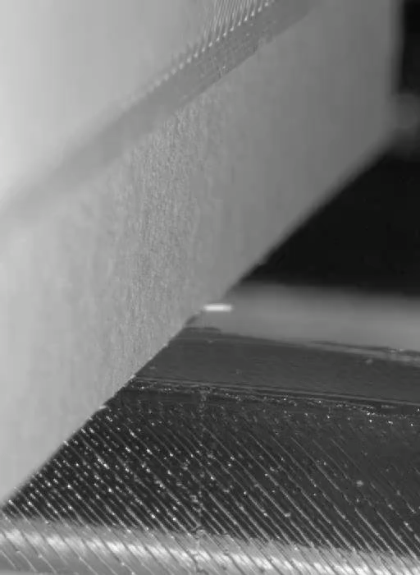
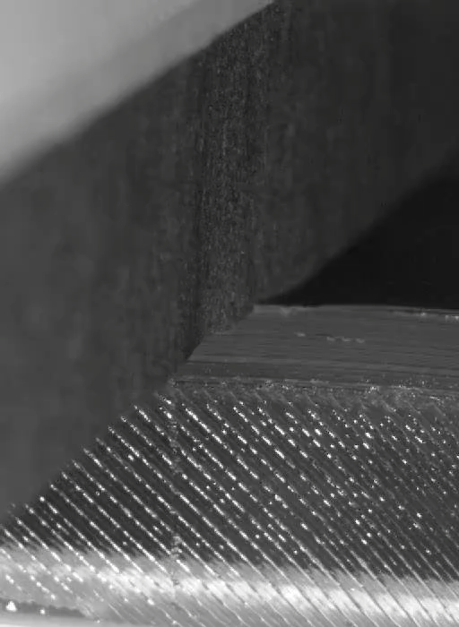
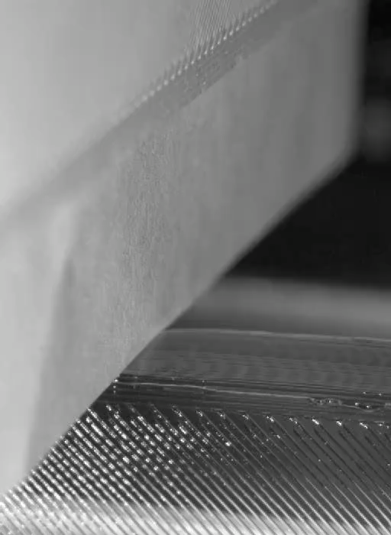
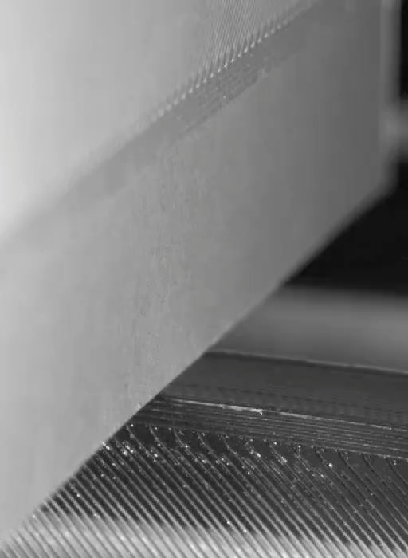
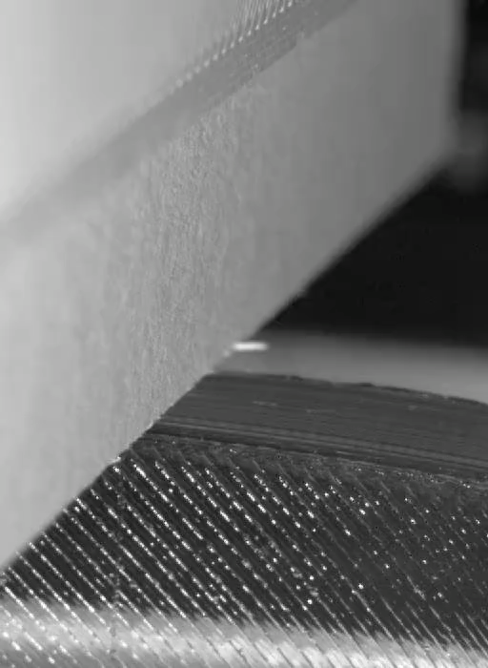
… revealing when buckling, indentation and cutting occurs
Cutting
Buckling
Indentation
Notes:
6 different videos and corresponding stress measurements?
interaction behavior = regime
Label the regimes

Slide 5
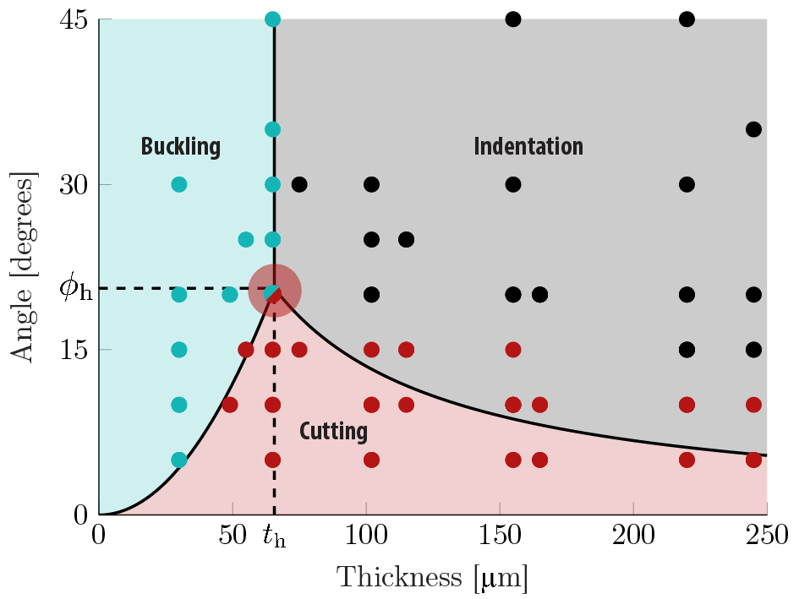
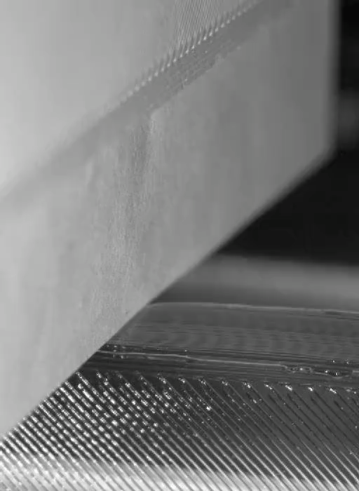
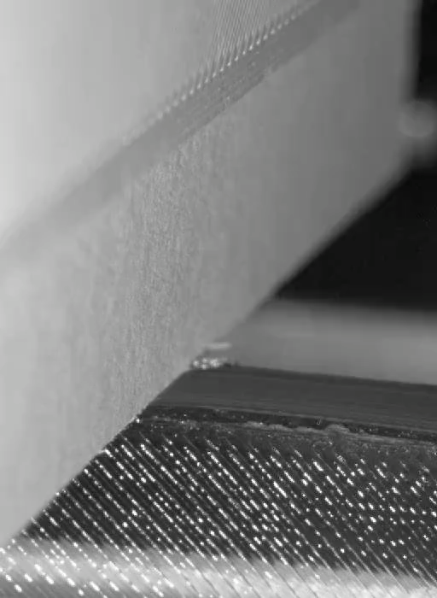
A parametric sweep revealed a limited cutting regime
Notes:
Joke: Science more dangerous than nature
make red dot appear
velocity - will that change the phase diagram
Index – h is italic & roman – be consistent

Slide 6
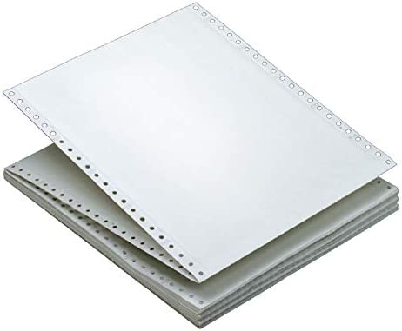
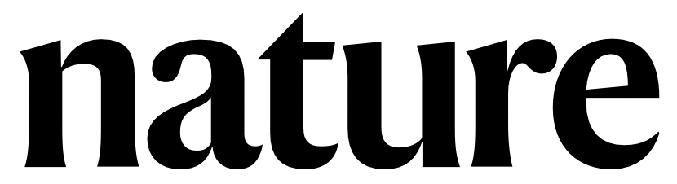
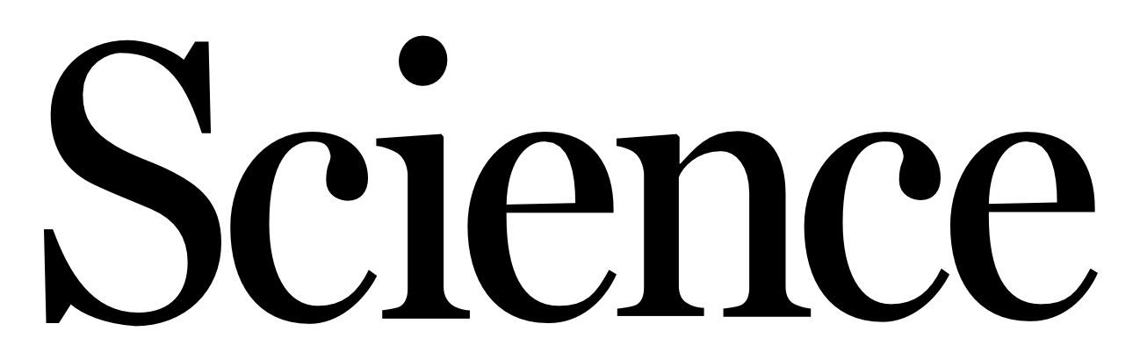
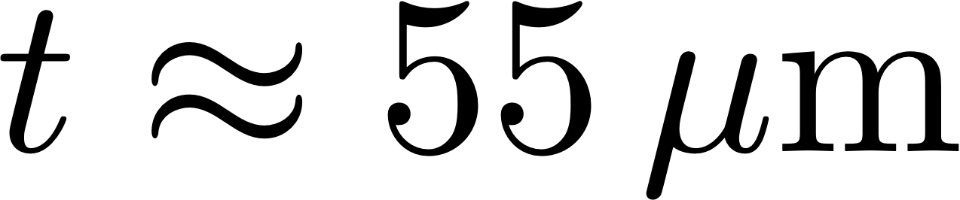
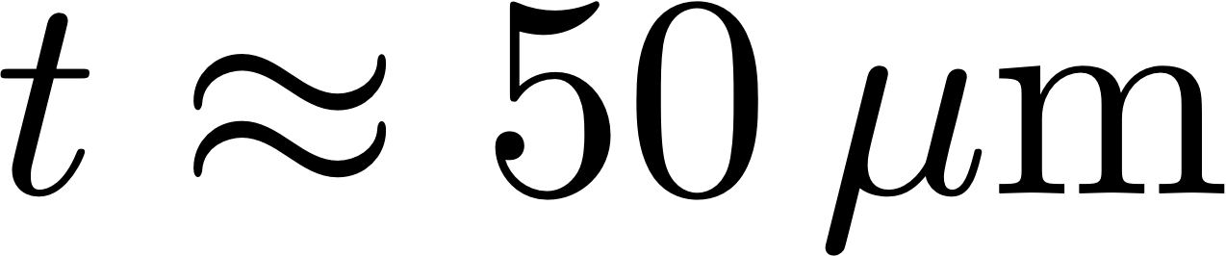
And the most hazardous thickness: 65 μm
This is close to dot-matrix printer paper,
but the journals Nature and Science are also dangerous…….
Notes:
Joke: Science more dangerous than nature
make red dot appear
velocity - will that change the phase diagram
Index – h is italic & roman – be consistent

Slide 7
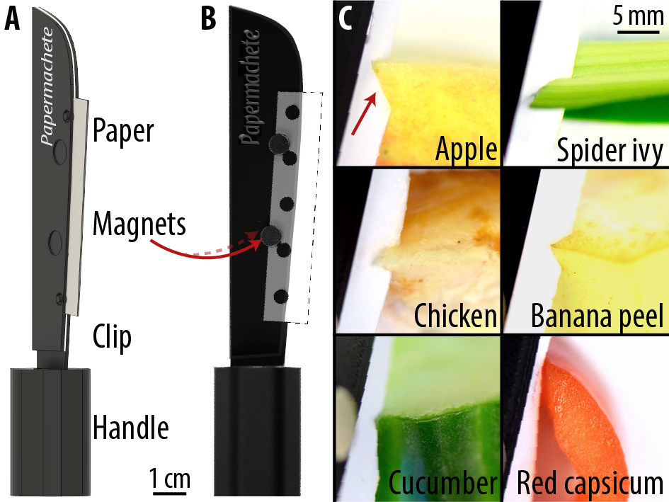
THE PAPERMACHETE
Based on our results, we developed the Papermachete, a cost-effective paper-based scalpel. It uses scrap paper blades and can easily cut vegetables and meat.
To 3D-print your own, use the files accessible at www.papermachete.org

